Slide 1
Group Exercise – Problem Structuring

Slide 2
Very brief intro to “Soft OR”
Soft OR
Analytical Thinking
Presentational skill
Toolkit of approaches*
*Further reading:
- Strategic Options Development and Analysis (Eden et al.)
- Soft Systems Methodology (Pidd et al.)

Slide 3
Examples – Rich Picture

Slide 4
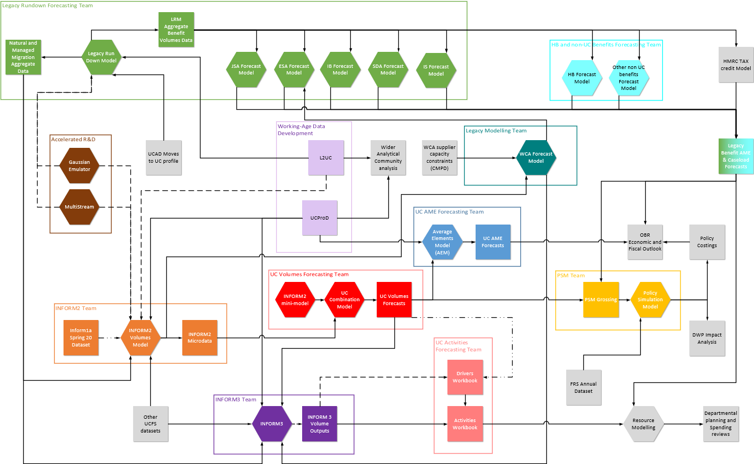
System mapping

Slide 5
Working with groups
Planning
Facilitation
Goal setting
Follow-up
Ownership and stakeholders
Purpose
Agenda
Managing input
Writing up
Following up
Active listening
Monitoring impact
… and behaviour

Slide 6
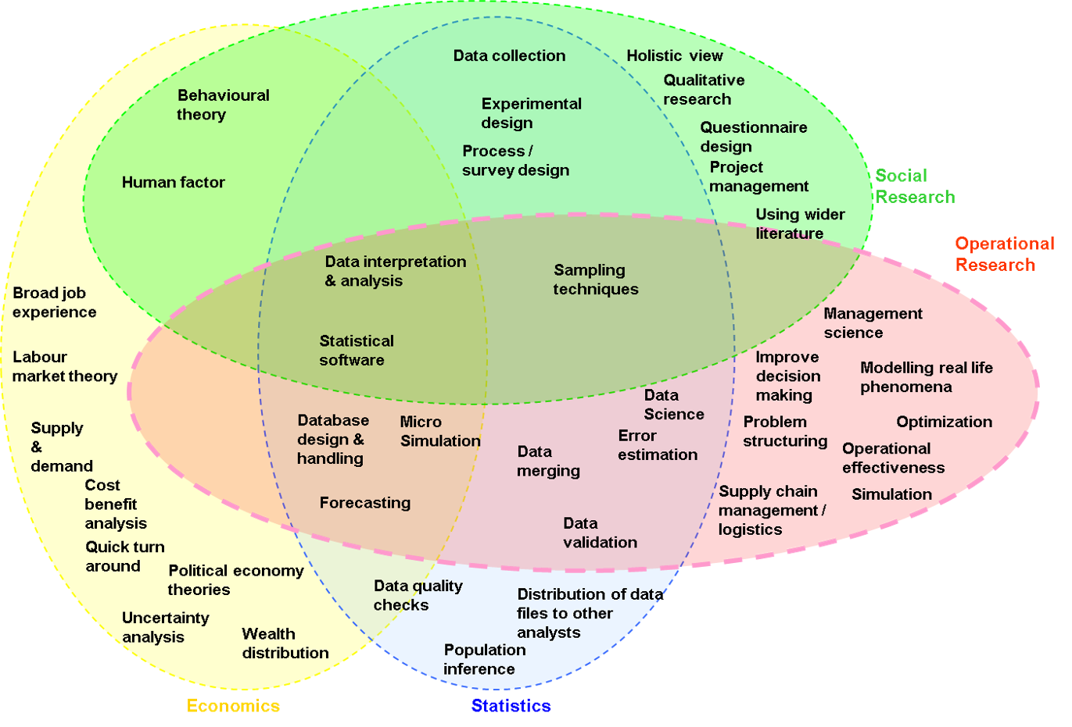
Stuff you already know!
Option | Cost | Impact | Deliverability
Option 1 | £ | !!!!! | Amber
Option 2 | ££ | !!!!!!!!!! | Green
Option 3 | £££ | !!! | Red

Slide 7
To structure a problem you must…
Define the problem
Involve people
Generate an outcome
Analytical questions
Embrace the complexity
Problem “owner” always involved and usually others as well
Be practical
Relevant factors
Explore and eliminate ambiguity
Consider data/evidence needed and how to obtain it
Address the whole problem
Add a useful structure
No “magic wands”
Context
What are the risks? Will it work?
Give appropriate value to knowledge and opinion
Clearly specify the analysis and data required
Be sparing with the call on their time
Ensure shared understanding of the issues
Write it up in an understandable format

Slide 8
Your task today
1. Read and discuss your assigned problem within your group
2. Produce a problem structure for it using suitable methods…
  You should consider:
  What are the relevant analytical questions?
  What factors do we need to know about to answer them?
  Are there any relationships between these factors?
  What analysis would you carry out throw light on the problem?
  What data is required and how will you obtain it?
  What are the risks for your approach and how will you mitigate them?
3. Present your proposed approach back to the wider group
4. You will need to manage your time!

Slide 9
Please note
The following task is based on a plausible situation for a department with the responsibilities and scale of DWP.
Is is however not real situations. They have been invented purely for this exercise.

Slide 10
Task: Local office efficiency
There is a network of local offices that deliver face-to-face employment services, as well as other support, to claimants of social security benefits. They also work with a number of local partner organisations to improve employment opportunities for claimants.
A manager in a district where it has been difficult to recruit staff recently, has asked for help to help streamline the way in which these local offices deliver their services and, in particular, deal face-to-face with benefit claimants.
What approaches would you propose to investigate what improvements could be made?

Slide 11
Feedback/Q&A
How did you find it working on an open-ended task like this?
What difficulties did you encounter?
How did you overcome them?
What have you learned?
What did you enjoy?
How will this experience change how you approach things in the future?

Slide 12
Backup material

Slide 13
Backup task: Complaints
Senior operational managers are concerned about a recent increase in complaints from clients.
Anecdotal evidence from the front-line suggests that these complaints revolve around the time taken to process benefit claims.
You have been asked to produce options to improve the situation so that decisions can be made on these.
What approach would you propose?

Slide 14
Backup task: New benefit
The department is part-way through the rollout of a new social security benefit. This involves interacting with new types of customer and is being delivered through a complex national programme working across geographical areas and client-groups.
The responsible director in Operations has asked you how to ensure there are enough staff available to carry out back-office work to process claims and claimant changes of circumstance over the next 12 months.
What analysis would you propose to throw light on this problem?

